Slide 1




AI Research
`
© Conestoga College. All rights reserved.

Slide 2

Team
Supervisor | Member
Sean Yo | Jongeon Lee
 | Wei-Hsiang Chen
 | Eunie Jo
 | Arsh Chauhan

Slide 3

Sprint Goal
Data Collection & Processing
Course Data Collection
Data Processing & Transformation
DTA System Enhancement
Enhancing the current frontend and backend by integrating the demo program from the previous sprint demo.

Slide 4
Data Collection & Processing
Successfully obtained all 4 course contents
Software Quality
Big Data
Virtual Reality Tech Lab 1
Information Technology Operations & Project Management
From Collection to Validation: Data Processing Step
Course Data Collected
Reviewed & Uploaded
Data Normalization
Data Analyzed
Requesting Missing Data

Slide 5
Data Collection & Processing
Confirmed all data is parsable after validation
Item | File type | Parsing Feasibility
Syllabus | .xml | possible
Schedule | .xml | Possible
Grades & Assessments | .xml | Possible
Rubrics | .xml | Possible
Announcements | .xml | Possible
Lecture Materials | .pptx, .pdf, .mp4 | Possible
Metadata Files | .xml | Possible
Quiz Files | .xml | Possible
Practice Files | .docx, .pdf | Possible
Reference Materials | .mp4 | Possible
Instructional Plan | .pdf | Possible
Assignment Files | .docx | Possible
Exam Files | .docx | Possible

Slide 6

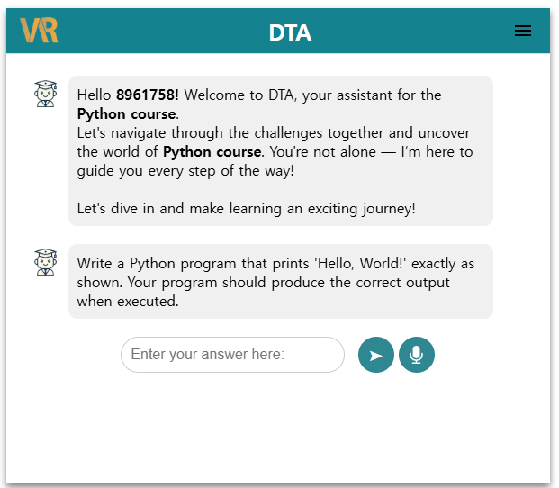
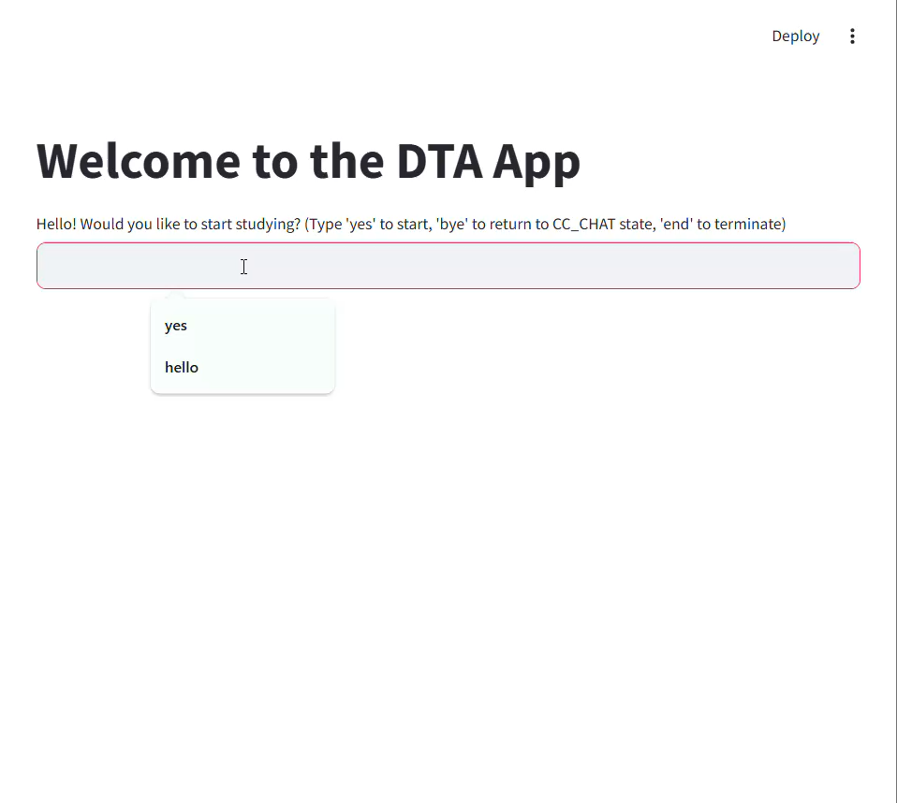
DTA System Enhancement

Slide 7
Next Plan
Data normalization
Data cleaning & validation
DTA System Enhancement
Keep working on it.

Slide 8
Q & A

